Slide 1
Case Study
The Shopping cart program
- Rohan Deshmukh

Slide 2
TASK : Create a shopping cart with the following basic functionality
Display the list of items available in the store, along with the corresponding quantities currently in stock and the cost per item
Ask the customer to enter the number of quantities required for each item.
Display a message if the item is out of stock. Accept customer name and delivery address as the input.
Calculate delivery charges based on the distance of the delivery address from the store, as shown below:
$10 for up to 5 miles
$12 between 5-10 miles
$14 between 10-15 miles
$20 for beyond 15 miles
Display the final bill with the items purchased and the customer details
The program should keep running in an infinite loop and prompt the user to enter "yes" to continue and enter "no" to terminate the program.
The items sold to a customer must automatically be updated to display the correct stock levels to the next customer.
Use Nested Dictionaries for storing the items and the corresponding quantities costs

Slide 3
Flow of program
Using Nested dictionary to store data for our shopping cart program
Making the code in while loop for repetative working of code
Displaying the data in tabular format for customer to see.
Asking series of question to get know customer needs and store it in dictionary
Check the store quantity and customer requirement matches
Get Customer details for delivery and distance from store
Show final bill with item name quantity and total cost per item
For total cost add total cost per item and distance delivery charges
Make changes in store quantity for next customer to know proper availability
Ask question for continuation for while condition input

Slide 4
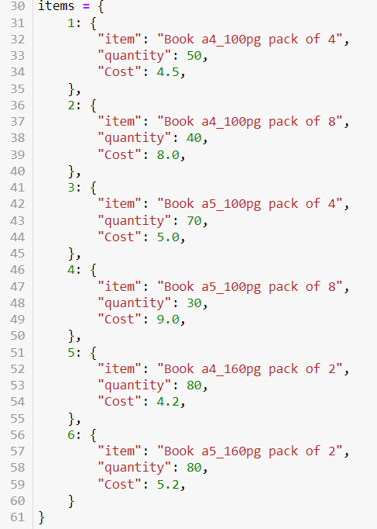
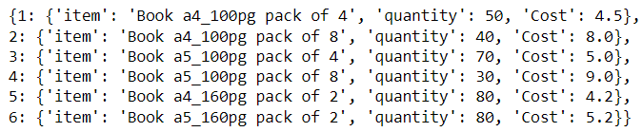
Step 1:
Over hear I created simple nested data set called “items” for book for the shopping cart store
Input code
output

Slide 5
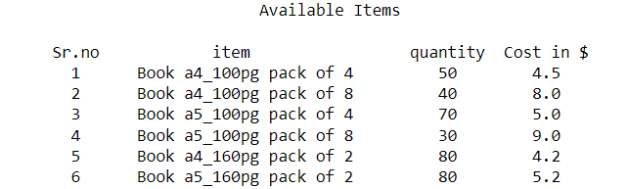
Step 2:
Over hear I used % spacing method to display in tabular format and for loop to print data from Dictionary
Code:
Output:

Slide 6
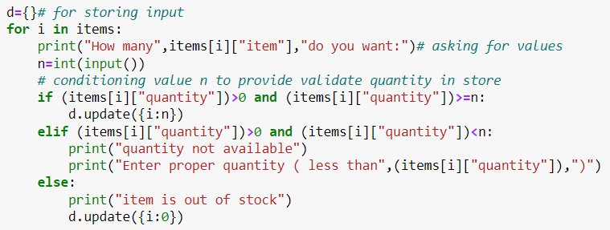
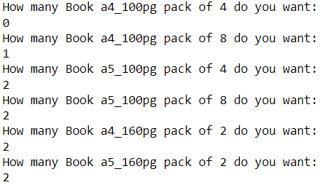
Step 3:
Over hear we are asking question using for loop and storing its value in n and we are checking the condition of n as well as available quantity in store if not it will populate its value as ZERO
Code:
Output:

Slide 7

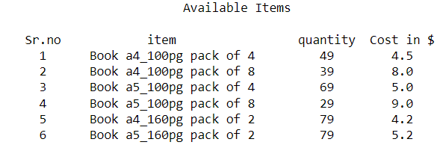
Step 4:
Over hear we are over writing values after the sale is complete and storing it in main data set
Code:
Output:

Slide 8
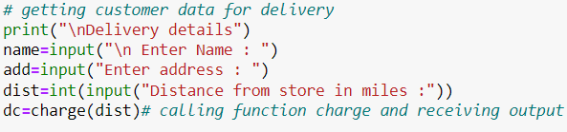
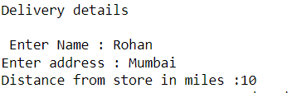
Step 5:
Over hear we are asking and storing customer data for delivery purpose
Code:
Output:

Slide 9
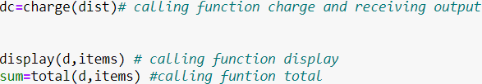
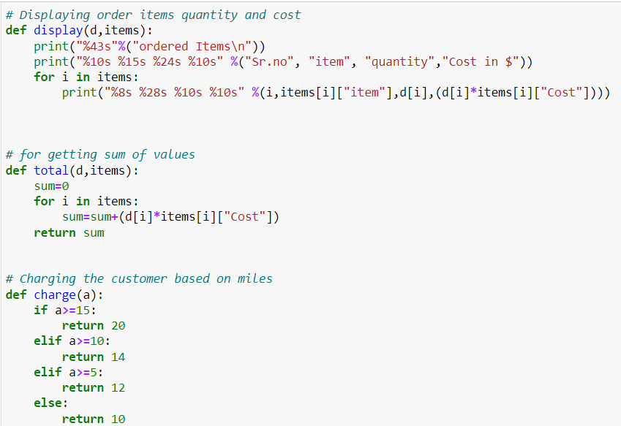
Step 6:
Over hear we are calling multiple function for addition, displaying and charge calculation
Code:

Slide 10
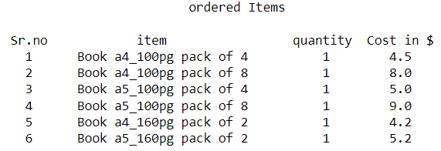
Step 6:(Contn)
Output of display function :

Slide 11
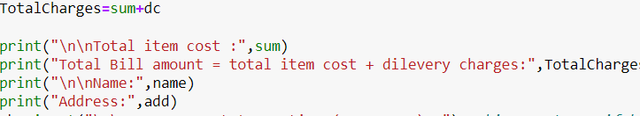
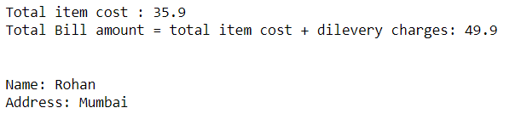
Step 7:
Over hear we are displaying all Total item cost , Total Bill amount and delivery details to customer
Code:
Output:

Slide 12
summary
In this task we used Functions , Condition statements, Loops, Spacing method , User input to get desired output
We Also got to know about Nested Dictionary how to store, retrieve and update the data

Slide 13
Thank you

